Slide 1
Matthew 27
scriptureandviolence.org
Notes:
This slideshow is designed be used as a short teaser or introduction at the beginning of the event, before beginning group discussion using the Scripture Discussion Guide on Matthew 27. It begins by inviting participants to share their experiences briefly (slide 2). The rest of the slides are designed simply to be read aloud by the leader or facilitator, with no discussion. Later in the event, participants can return to the slideshow and discuss its contents if desired.

Slide 2
Sharing your experiences:
Have you ever heard someone say, “The Jews killed Jesus,” or that all Jews are cursed because of Jesus?
Notes:
Sharing Question: Ask this question of participants. If anyone has had such an experience, invite them to describe it briefly. Then move on to the rest of the slideshow.

Slide 3
In 2019, a survey of 800 US adults showed:
27% believe the Jews killed Jesus.
https://www.jta.org/2020/01/29/united-states/adl-poll-anti-semitic-violence-is-on-the-rise-in-america-but-anti-semitic-attitudes-are-not
Notes:
Read the words of the slide aloud, then move on to the next slide.

Slide 4
In 2018, Jill Kargman’s 4th grade son was told by a classmate at his New York school:
“I’m a fan of Hitler! God sent Hitler down to kill the Jews because they nailed Jesus to the cross.”
https://www.tabletmag.com/sections/news/articles/deep-cuts-jill-kargman
Notes:
Read the words of the slide aloud, then move on to the next slide.

Slide 5
French philosopher Bernard-Henri Levy recalls being bullied as a child by other children in Paris, who said:
“You don’t get to have Christmas presents because you’re a dirty Jew and Jews killed Jesus.”
https://www.timesofisrael.com/philosopher-bernard-henri-levy-revisits-jewish-roots-in-new-book/
Notes:
Read the words of the slide aloud, then move on to the next slide.

Slide 6
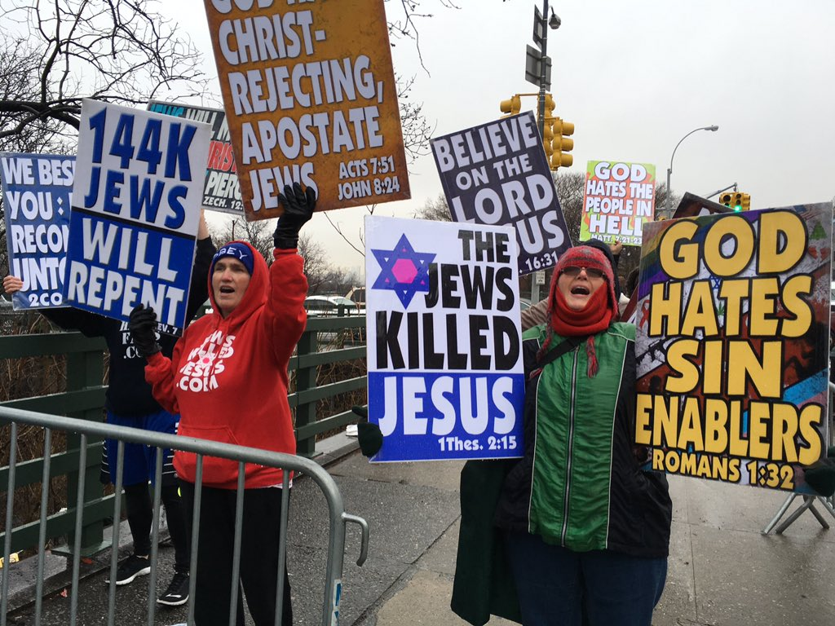
People from Westboro Baptist Church protesting outside Yeshiva University on 27 March 2017:
https://forward.com/fast-forward/367282/watch-to-tune-of-hava-nagila-westboro-baptist-church-says-jews-must-repent/
Notes:
[Another source for this image: https://twitter.com/simonesomekh/status/846425122164674560]

Slide 7
On another note, the New Testament has its share of challenging passages…
Notes:
Read the words of the slide aloud, then move on to the next slide.

Slide 8
“It is just of God to repay with affliction those who afflict you, …, when the Lord Jesus is revealed from heaven with his mighty angels in flaming fire, inflicting vengeance on those who do not know God and on those who do not obey the gospel of our Lord Jesus. These will suffer the punishment of eternal destruction.”
- 2 Thessalonians 1:6-9 (NRSV)
Notes:
Read the words of the slide aloud, then move on to the next slide.

Slide 9
In Acts 5, two members of the Church are killed because they lie about how much money they donated. God kills them, and it seems as if the apostle Peter commands it.
Notes:
Read the words of the slide aloud, then move on to the next slide.

Slide 10
“Slaves, accept the authority of your masters with all deference, not only those who are kind and gentle but also those who are harsh.”
- 1 Peter 2:18 (NRSV)
(Church members apparently own slaves.)
Notes:
Read the words of the slide aloud, then move on to the next slide.

Slide 11
“Wives, be subject to your husbands, as is fitting in the Lord.”
- Colossians 3:18 (NRSV)
Notes:
Read the words of the slide aloud, then move on to the next slide.

Slide 12
“I saw heaven opened, and there was a white horse! Its rider is called Faithful and True, and in righteousness he judges and makes war. … He is clothed in a robe dipped in blood… And the armies of heaven, …, were following him… From his mouth comes a sharp sword with which to strike down the nations.”
- Revelation 19:11-15 (NRSV)
Notes:
Read the words of the slide aloud. After this slide, move directly into discussion of Matthew 27, using the Scripture Discussion Guide.

